Slide 1
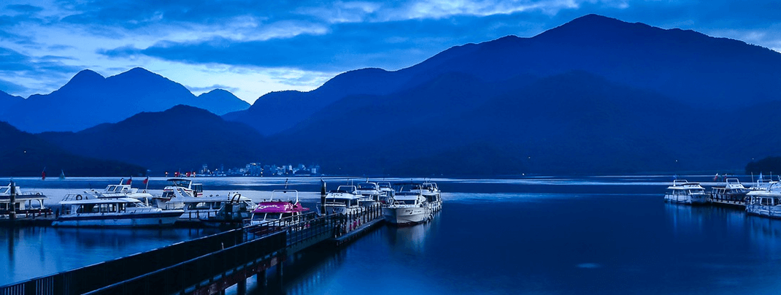
HW11_Sun Moon Lake
2022 Algorithm

Slide 2
Assignment Requirement
Sun Moon Lake is the second largest lake in Taiwan. It is also a famous tourist attraction.
Give you a 2D array which means the height of the mountains.
And count the total water volume in this array.
Note: If surrounding elements are higher then a element, then it will be a lake. The water volume of this lake is equal to (the lowest height of surrounding elements – height of this element)

Slide 3
Example 01
Input: {{2, 5, 3}, {7, 1, 6}, {9, 8, 4}}
Output: 4
Explanation:
2 | 5 | 3
7 | 1 | 6
9 | 8 | 4
Water volume = 5 – 1 = 4

Slide 4
Example 02
Input: {{1, 3, 2, 4, 5, 2}, {2, 1, 3, 2, 1, 4}, {2, 3, 4, 5, 7, 8}}
Output: 4
Explanation:
1 | 3 | 2 | 4 | 5 | 2
2 | 1 | 3 | 2 | 1 | 4
2 | 3 | 4 | 5 | 7 | 8
Water volume = (2 - 1) + (3 - 2) + (3 - 1)
= 1 + 1 + 2 = 4

Slide 5

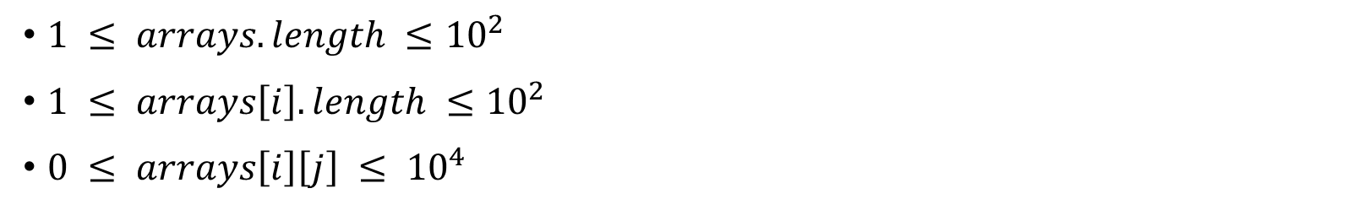
Constraints
$1 ≤ arrays.length ≤{10}^{2}$
$1 ≤ arrays\left[i\right].length ≤{10}^{2}$
$0 ≤ arrays\left[i\right]\left[j\right] ≤ {10}^{4}$
Don’t import anything in your program.
Please inherit from this abstract class:
Please name your class as HW11_學號_版本號

Slide 6
About Test data
為了避免再有同學對測資產生誤會，補充說明如下：
1. 湖可以是任意不規則的形狀，而不是只有長方形。且湖泊也不一定只有一個。
3 | 3 | 4 | 5 | 6
4 | 2 | 4 | 3 | 5
5 | 1 | 0 | 4 | 4
4 | 1 | 1 | 2 | 3
1 | 5 | 4 | 5 | 4
To avoid further misunderstandings by students about the test data, the supplementary explanation is as follows:
1. Lakes can be of any irregular shape, not just rectangles. And there is no guarantee that there will be only one lake.
Answer: 12

Slide 7
About Test data
2. 湖中間如果有方塊高於水平面，則形成小島。且該格不應計算水量。
3 | 3 | 4 | 5 | 6
4 | 2 | 2 | 1 | 5
5 | 1 | 4 | 0 | 4
4 | 1 | 1 | 2 | 3
4 | 5 | 4 | 5 | 4
2. If there is a block in the middle of the lake that is higher than the water level, an island is formed. And this grid should not count water.
Answer: 14

Slide 8
About Test data
3. 只要能形成湖泊的地方，都應該視為湖泊。也就是說求出可以形成湖泊的最大水量。
3 | 3 | 3 | 3 | 3
3 | 2 | 2 | 2 | 3
3 | 2 | 1 | 2 | 3
3 | 2 | 2 | 2 | 3
3 | 3 | 3 | 3 | 3
3. Wherever a lake can be formed, it should be regarded as a lake. That is to say, find the maximum amount of water that can form a lake.
Answer: 10

Slide 9
About Deadline
由於有同學反應正值期末考周，希望可以延長作業的繳交期限。
助教們會再觀察繳交情況後再做決定，最晚會在6/8(三)前給出回應。
Because some students responded that it was the final exam week, they hoped that the deadline for submitting assignments could be extended.
The teaching assistants will observe the handing situation before making a decision, and will give a response before 6/8 (Wednesday) at the latest.

